Slide 1
Contextual Analysis of Tennis Playing Styles
Data Mining and Machine Learning – A.A. 2024-2025
Andrea Innocenti

Slide 2
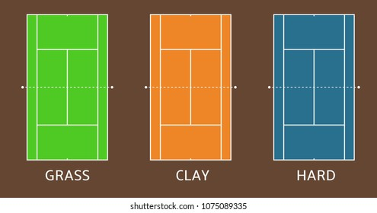
Problem description
🎯 Objective Identify and analyze tactical playing styles in professional tennis using real shot-level data, with a focus on how these styles vary by match context.
💡 Key Idea Analyzing each player's behavior separately in distinct tactical contexts, defined by:
Surface: clay, hard, grass.
Point situation: serve/return.
→ 6 independent contexts

Slide 3
ML techniques adopted
Clustering
Search for clusters of players with similar styles.
For each player, in each context, a set of features is costructed.
Sequential pattern analysis
For each player, search for frequent sequences of shots
Applications
Match preparation: Have an overview of the opponent playing style, by looking at the cluster he belongs to.
Style tracking: Track how a player’s tactical style changes across the contexts.
Frequent shot sequences: Analyze which sequences are frequently used and which of them lead to a winning point.

Slide 4
Dataset description
~ 4000 matches from ATP since 2020 to 2024, ~ 600’000 points, 411 players.
Shot: characterized by: type of shot (backhand, forehand, volley, …), direction, depth;
codified by alphanumeric characters: e.g. b37 = b: backhand, 3: down the line, 7: very deep.
Point: a sequence of shots: e.g. <b37, f35, f17, …, b17> ;
labeled as won/loss, metadata info: type of point (1°/2° serve), outcome (winner, forced/unforced error).

Slide 5

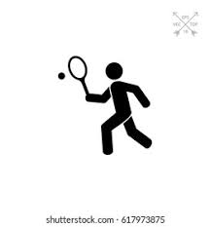

Datasets creation and preprocessing
+
Row point-level dataset
Row point-level dataset + surface
x 6
Player 1
Feature datasets:
Tuple: player
Column: feature
Point-level data for each player in each context.
:
:
x N x 6
Player N

Slide 6
Datasets creation and preprocessing
Features – 20 in total
Generic: ace rate, average point length, average response depth, …
Opening phase: informations about the first 3 shots of the point:
forehand % as 1° shot, backhand % as 2° shot, ...
correlation matrix analysis
Some features are compacted – 14 on response, 16 on serve:
In the opening phase features:
forehand % as 1° shot, backhand % as 1° shot forehand % / backhand % as 1° shot
z-score normalization
CLEANED DATASETS

Slide 7
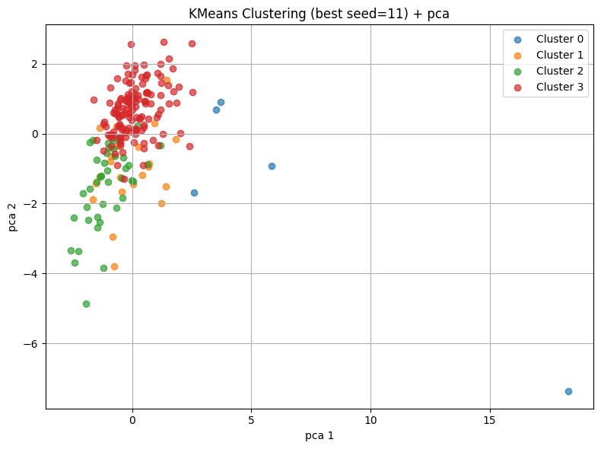
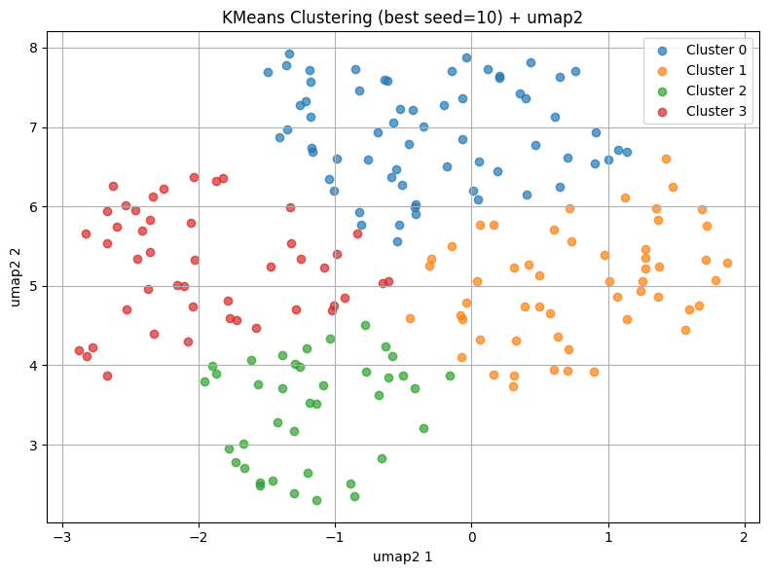
Clustering
Steps:
Hopkins value: between 0.7 and 0.8 across all datasets, averaged over 30 iterations good cluster tendency
Number of clusters: 4
Dimensionality reduction: PCA vs UMAP
Silhouette score (best): 0.183
DBI score (best): 1.794
Silhouette score (best): 0.402
DBI score (best): 0.815
UMAP 2D

Slide 8
Clustering
UMAP: Uniform Manifold Approximation and Projection for Dimension Reduction.
From UMAP website: "UMAP is a fairly flexible non-linear dimension reduction algorithm. It seeks to learn the manifold structure of your data and find a low dimensional embedding that preserves the essential topological structure of that manifold.”
Trustworthiness: metric that evaluate how well UMAP transforms the original dataset, measuring whether points that are close in the UMAP space were also close in the original space.
Trustworthiness ∈ [0,1], 1 = perfect trustworthiness.
UMAP 2D ~ 0.8
UMAP 8D ~ 0.83
UMAP 2D gives better silhouette and DBI score.

Slide 9
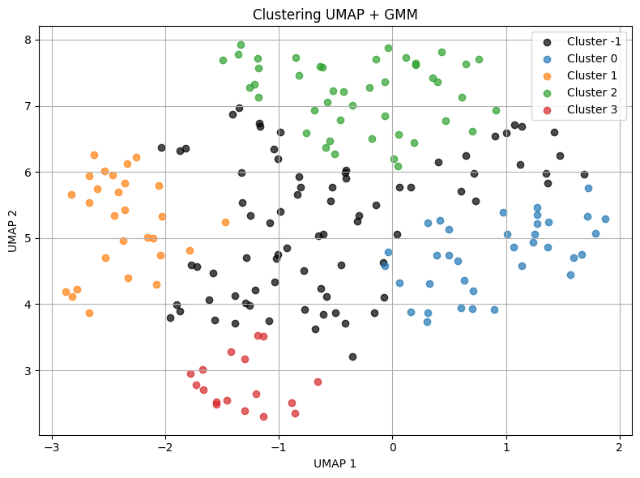
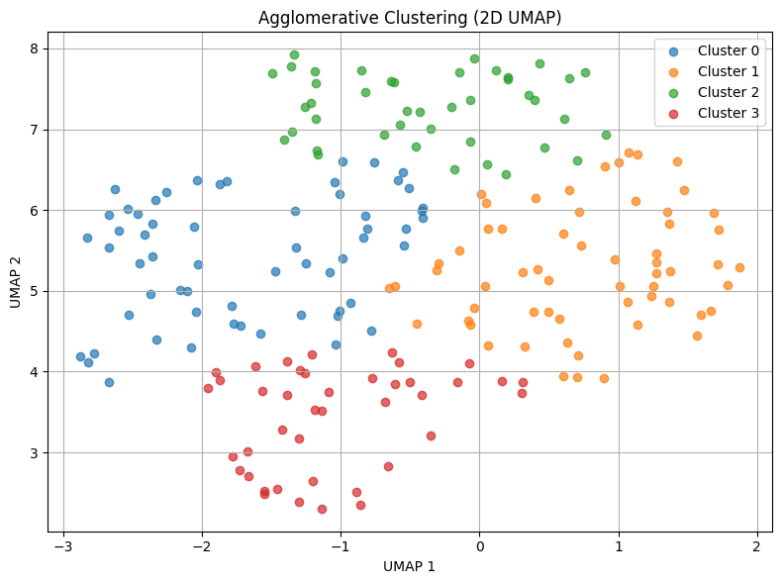
Clustering
Other methods tested: GMM and Agglomerative hierarchical based clustering
A GMM (Gaussian Mixture Model) is a probabilistic clustering algorithm that assumes the data is generated from a mixture of several multivariate Gaussian distributions. GMM does not assign points rigidly, instead, it computes for each point the probability of belonging to each cluster.
Silhouette score: 0.607
DBI score: 0.511
Probability treshold: 0.9
Linkage method: complete
Silhouette score: 0.366
DBI score: 0.833

Slide 10
Visualizing results
Player trajectory for Roger_Federer
Context = on response on clay
--- Cluster 2 ---
High-risk, aggressive baseliner, high
usage of dropshot
average_shot_length: - 0.1205
net_points_rate: + 0.0748
net_points_won_rate: - 0.0046
winners_rate: + 0.1507
unforced_errors_rate: + 0.0262
slices_rate: + 0.2838
dropshots_rate: + 0.0723
average_response_depth: + 0.0186
Top players in the cluster 2:
Carlos_Alcaraz - Felix_Auger_Aliassime - Karen_Khachanov - Sebastian_Korda
- Stefanos_Tsitsipas
Context = on response on grass
--- Cluster 1 ---
High winner percentage, slice user,
high net points rate
average_shot_length: + 0.1005
net_points_rate: + 0.1129
net_points_won_rate: - 0.0296
winners_rate: + 0.3068
unforced_errors_rate: - 0.0561
slices_rate: - 0.1299
dropshots_rate: + 0.1147
average_response_depth: - 0.0169
Top players in the cluster 1:
Grigor_Dimitrov - Hubert_Hurkacz –
John_Isner - Sebastian_Korda - Jiri_Lehecka

Slide 11
Sequential pattern analysis
Analysis focuses on the first 3 consecutive shots to provide clear, actionable insights for players.
Non-consecutive shots are excluded: harder to interpret and lack clear structure.
A full sequential pattern analysis was however tested, using freq_seq_enum() from seqmining (free-span like), but proved inefficient due to high computational cost.
Future work may explore relationships between non-consecutive shots for deeper tactical insights.

Slide 12
Sequential pattern analysis
Results for player Carlos Alcaraz:
Legend: * = winner, # = forced error, @ = unforced error
on serve on hard
Sequence: ['Serve body', 'backhand groundstroke, down the line,', 'backhand groundstroke, down the line,’]
| Support: 57
| Win percentage: 54%
| Most frequent outcome: @, won
on serve on grass
…
Time duration with Counter():
0.09308266639709473 s
Time duration with freq_seq_enum(): 0.5296885967254639 s

Slide 13
Bibliography
Dataset
https://github.com/JeffSackmann/tennis_MatchChartingProject
References
Johnattan Ontiveros, Harvard Sports, 2021. Sorting Strokes: Classifying Tennis Players Based on Stats and Style. https://harvardsportsanalysis.org/2021/07/sorting-strokes-classifying-tennis-players-based-on-stats-and-style
J. Wu, D. Liu, Z. Guo and Y. Wu, "RASIPAM: Interactive Pattern Mining of Multivariate Event Sequences in Racket Sports," in IEEE Transactions on Visualization and Computer Graphics, vol. 29, no. 1, pp. 940-950, Jan. 2023. https://ieeexplore.ieee.org/abstract/document/9906966

